Slide 1

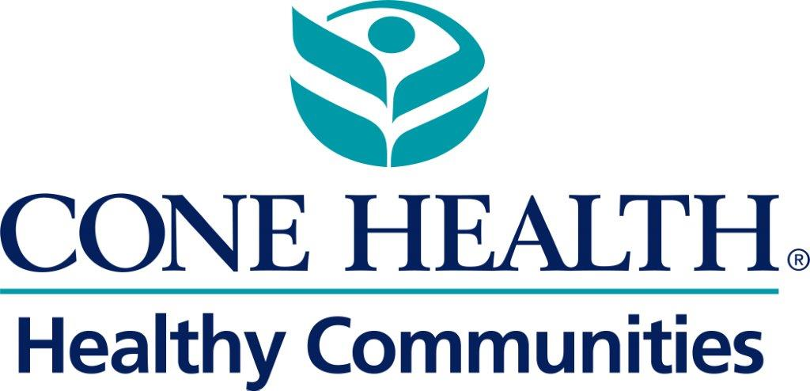
CHCS Childhood Asthma and Housing
Prevalence of Chronic Disease and
Acute Asthma Cone Health Encounters
Jamilla Pinder, Assist. Director- Healthy Communities
August 6, 2021
Notes:
Just another image example.

Slide 2
Agenda
Impact of childhood asthma on children, families and the community
The impact of childhood asthma from a health system and patient perspective
Who is most at risk in Greensboro and what the medical community is doing to better address the prevalence and incidence of asthma.
Build Health project

Slide 3
Definitions
•Social vulnerability refers to the potential negative effects on communities caused by external stresses on human health.
•Social Vulnerability Index (SVI)
–The CDC uses the US Census data to determine the social vulnerability of every census tract (subdivisions of counties for which the Census collects statistical data). https://www.atsdr.cdc.gov/placeandhealth/svi/fact_sheet/fact_sheet.html
–Tracts are ranked by 15 census variables, including poverty, lack of vehicle access, and crowded housing.
–These factors are grouped into SVI themes
•Socioeconomic status; Household Composition; Race/Ethnicity/Language; Housing/Transportation
•Asthma Utilization
–Includes visits at Cone Health ERs, Urgent Cares, and Inpatient stays for primary asthma-related problems between 2019 and present.
–School-aged children –5-18 years old
Notes:
This is a main content slide.

Slide 4
Greensboro and Surrounding Area SVI
Notes:
This is a main content slide.

Slide 5
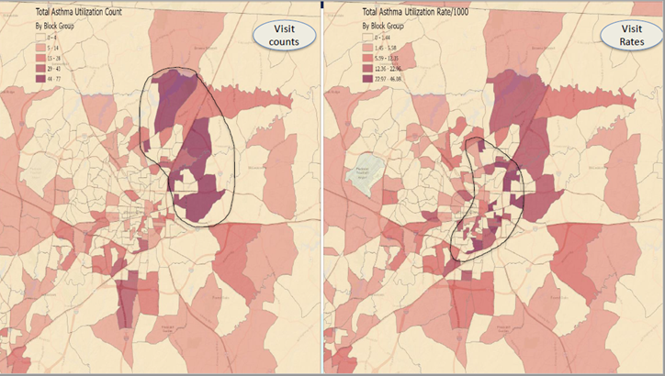
Notes:
This is a main content slide.

Slide 6
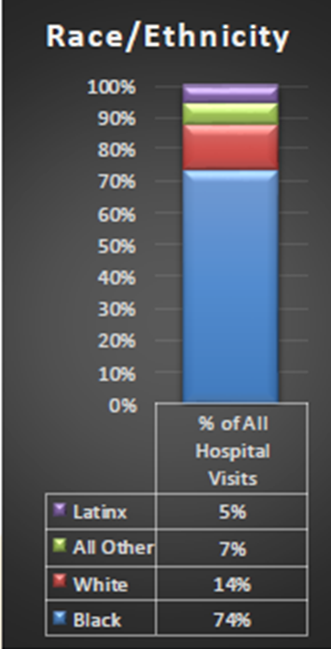
All Asthma related Hospital Visits in School Aged Children in Relation to Local Schools

Slide 7
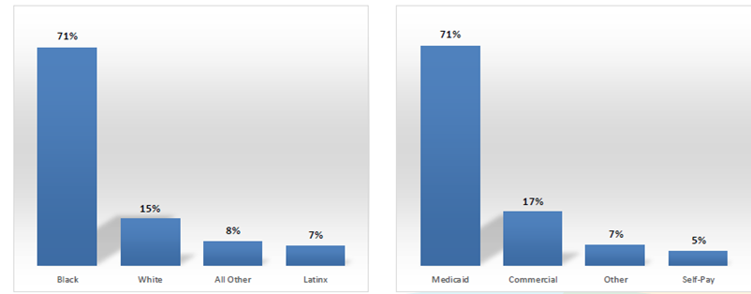
Unique Count of School aged Children with Asthma related Utilization
874 unique children
accounted for 1,144
ED, UC and IP visits

Slide 8
The things that matter most must never be at the mercy of the things that matter least.
~Johann Wolfgang von Goethe

