Slide 1
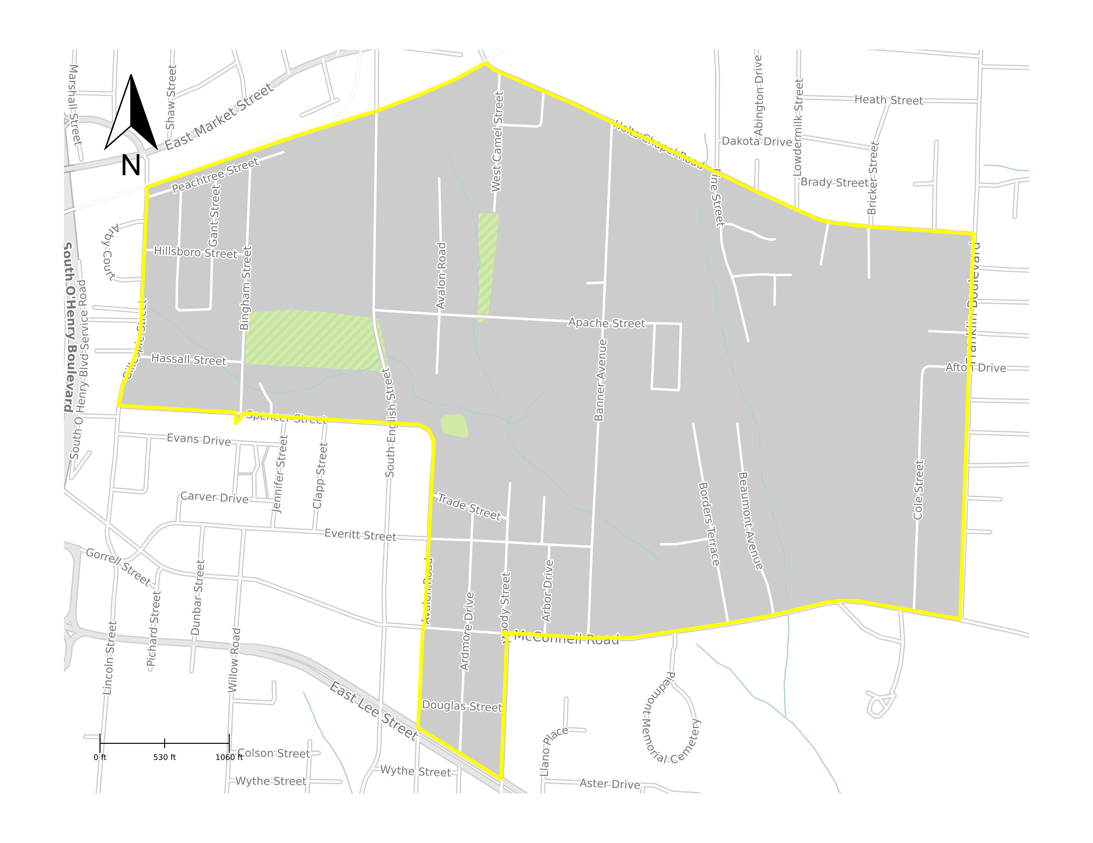
Cottage Grove/ Willow Oaks Area
870 households, 2,014 individuals
69% African American, 17% Hispanic, 1% Asian, 9% "some other race,"5.11% are of two or more races
16% of the population is over the age of 65
Median household income for the study area is $31,151 (36% less than Greensboro median)
39% of households make less than $25,000 annually
31% of individuals live in poverty in the area
This urban, neighborhood of color is the site of a pre-regulatory landfill.
Source: ACS 2015-2019 BG 370810111011

Slide 2
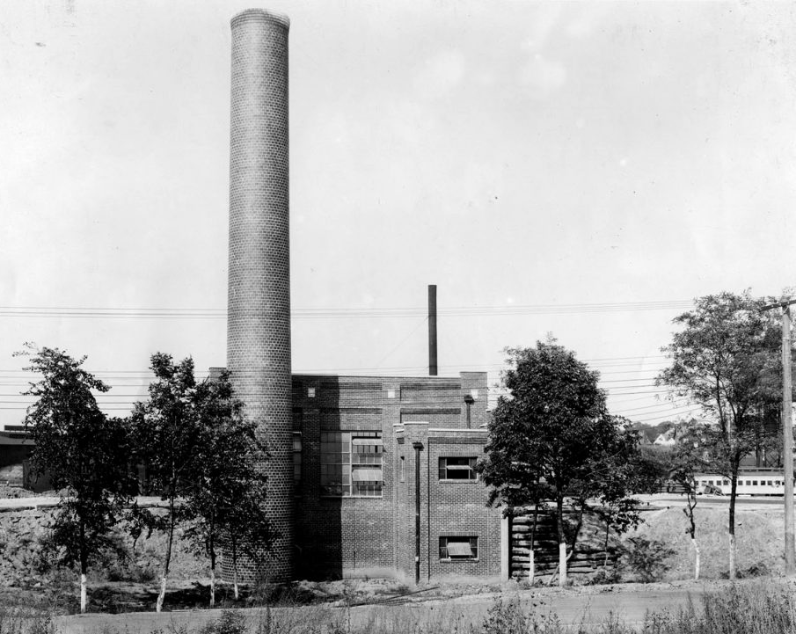
1922: City Council of Greensboro announced its plan to construct a new incinerator on the South Buffalo Creek.
1922: South Greensboro petitioned against the decision, 300 to 400 people, mainly women, met in local schoolhouse to oppose

Slide 3
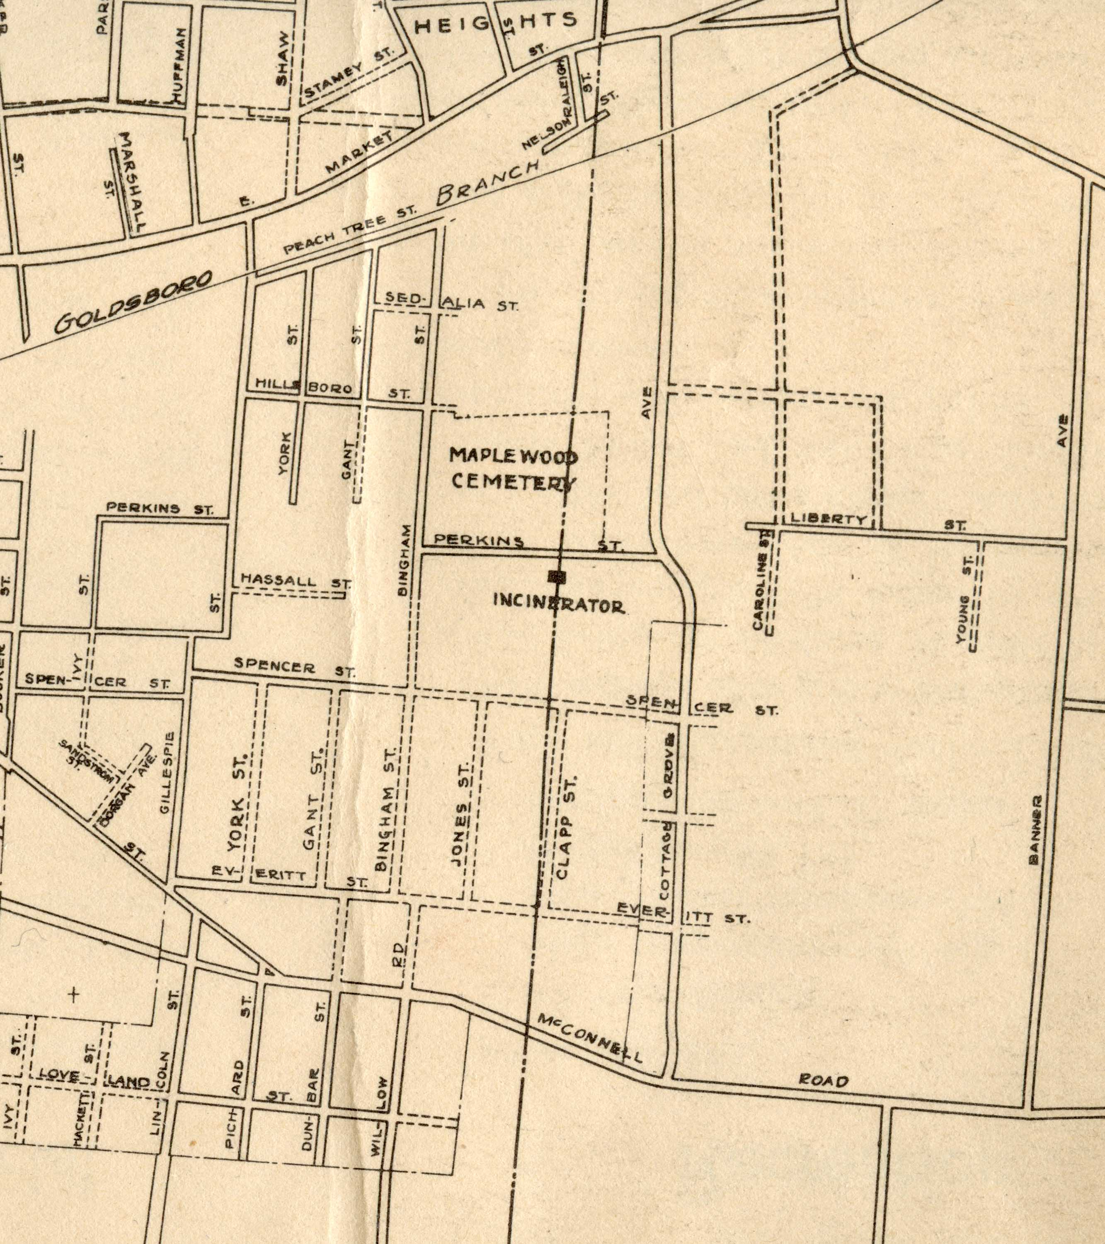
1925: incinerator begins operation, and the ash is buried in a landfill along the creek
1930s - 40s: footprint of the landfill expands as City acquires additional land. Area begins to become more settled as subdivisions are created next to landfill. Incinerator stops being used in the early 40s, converting to a solid waste disposal only.
1953: landfill was closed with materials being covered over with soil
1937
Notes:
1937

Slide 4
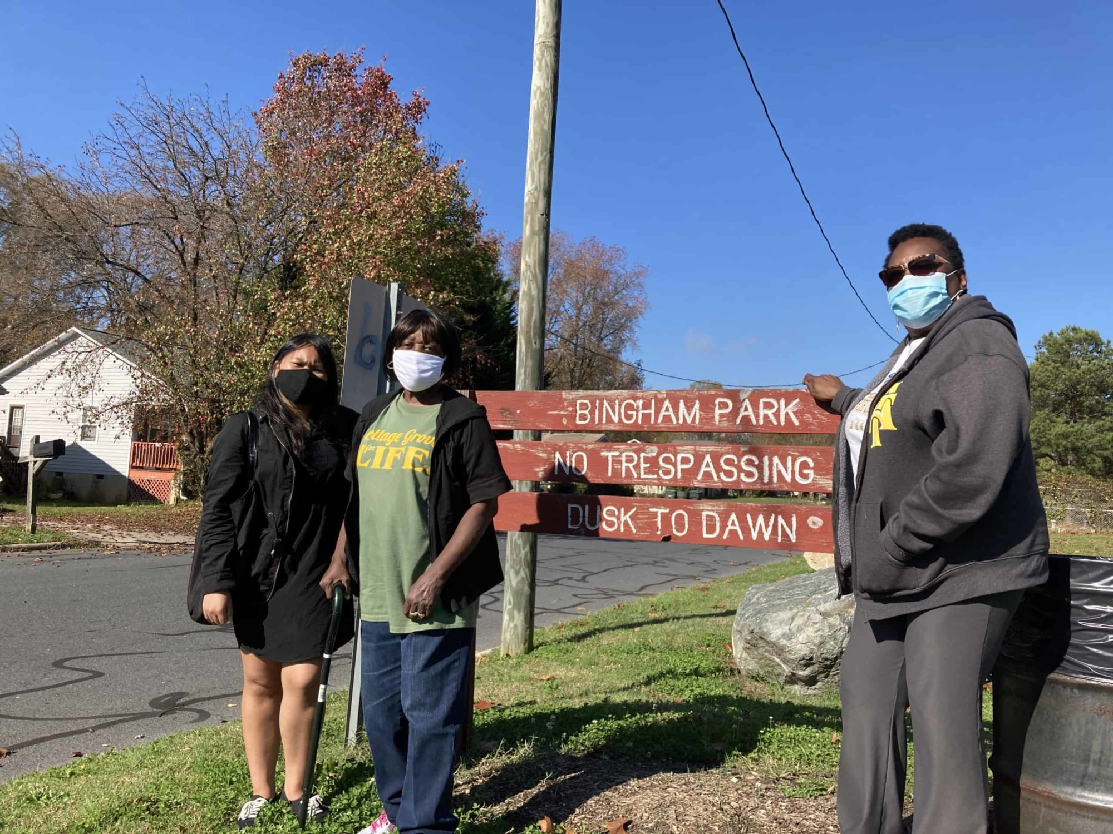
“Bingham Street landfill closed around 1953, its toxic contents buried over with soil, nothing more, because that was how it was done back then.”
1972: Bingham Park was established by the city with its amenities being a basketball court, baseball field, picnic tables and tents.

Slide 5
Geospatial Analysis

Slide 6
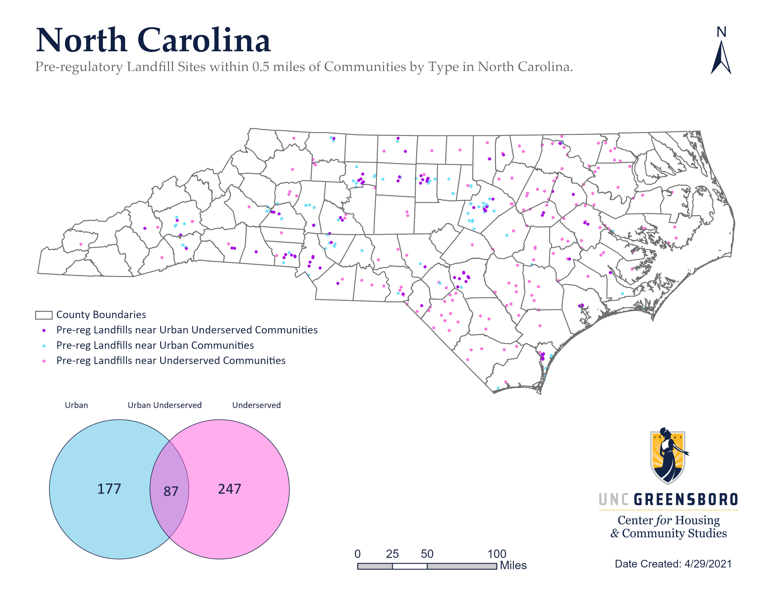
Questions:
Is the Bingham Park Landfill representative of a pattern of environmental racism where communities of color are disproportionately impacted?
What proportion of these sites are in urban underserved communities?

Slide 7
NC has 6,155 total block group-sized “communities,” and its geography spans 53,812 square miles.
598 block groups (9.7% of all) have at least one and as many as 3 landfills in them
And, 23% of block groups (1,430) accounting for 31.1% of NC geography are within 0.5 miles of a pre-regulatory landfill site.

Slide 8
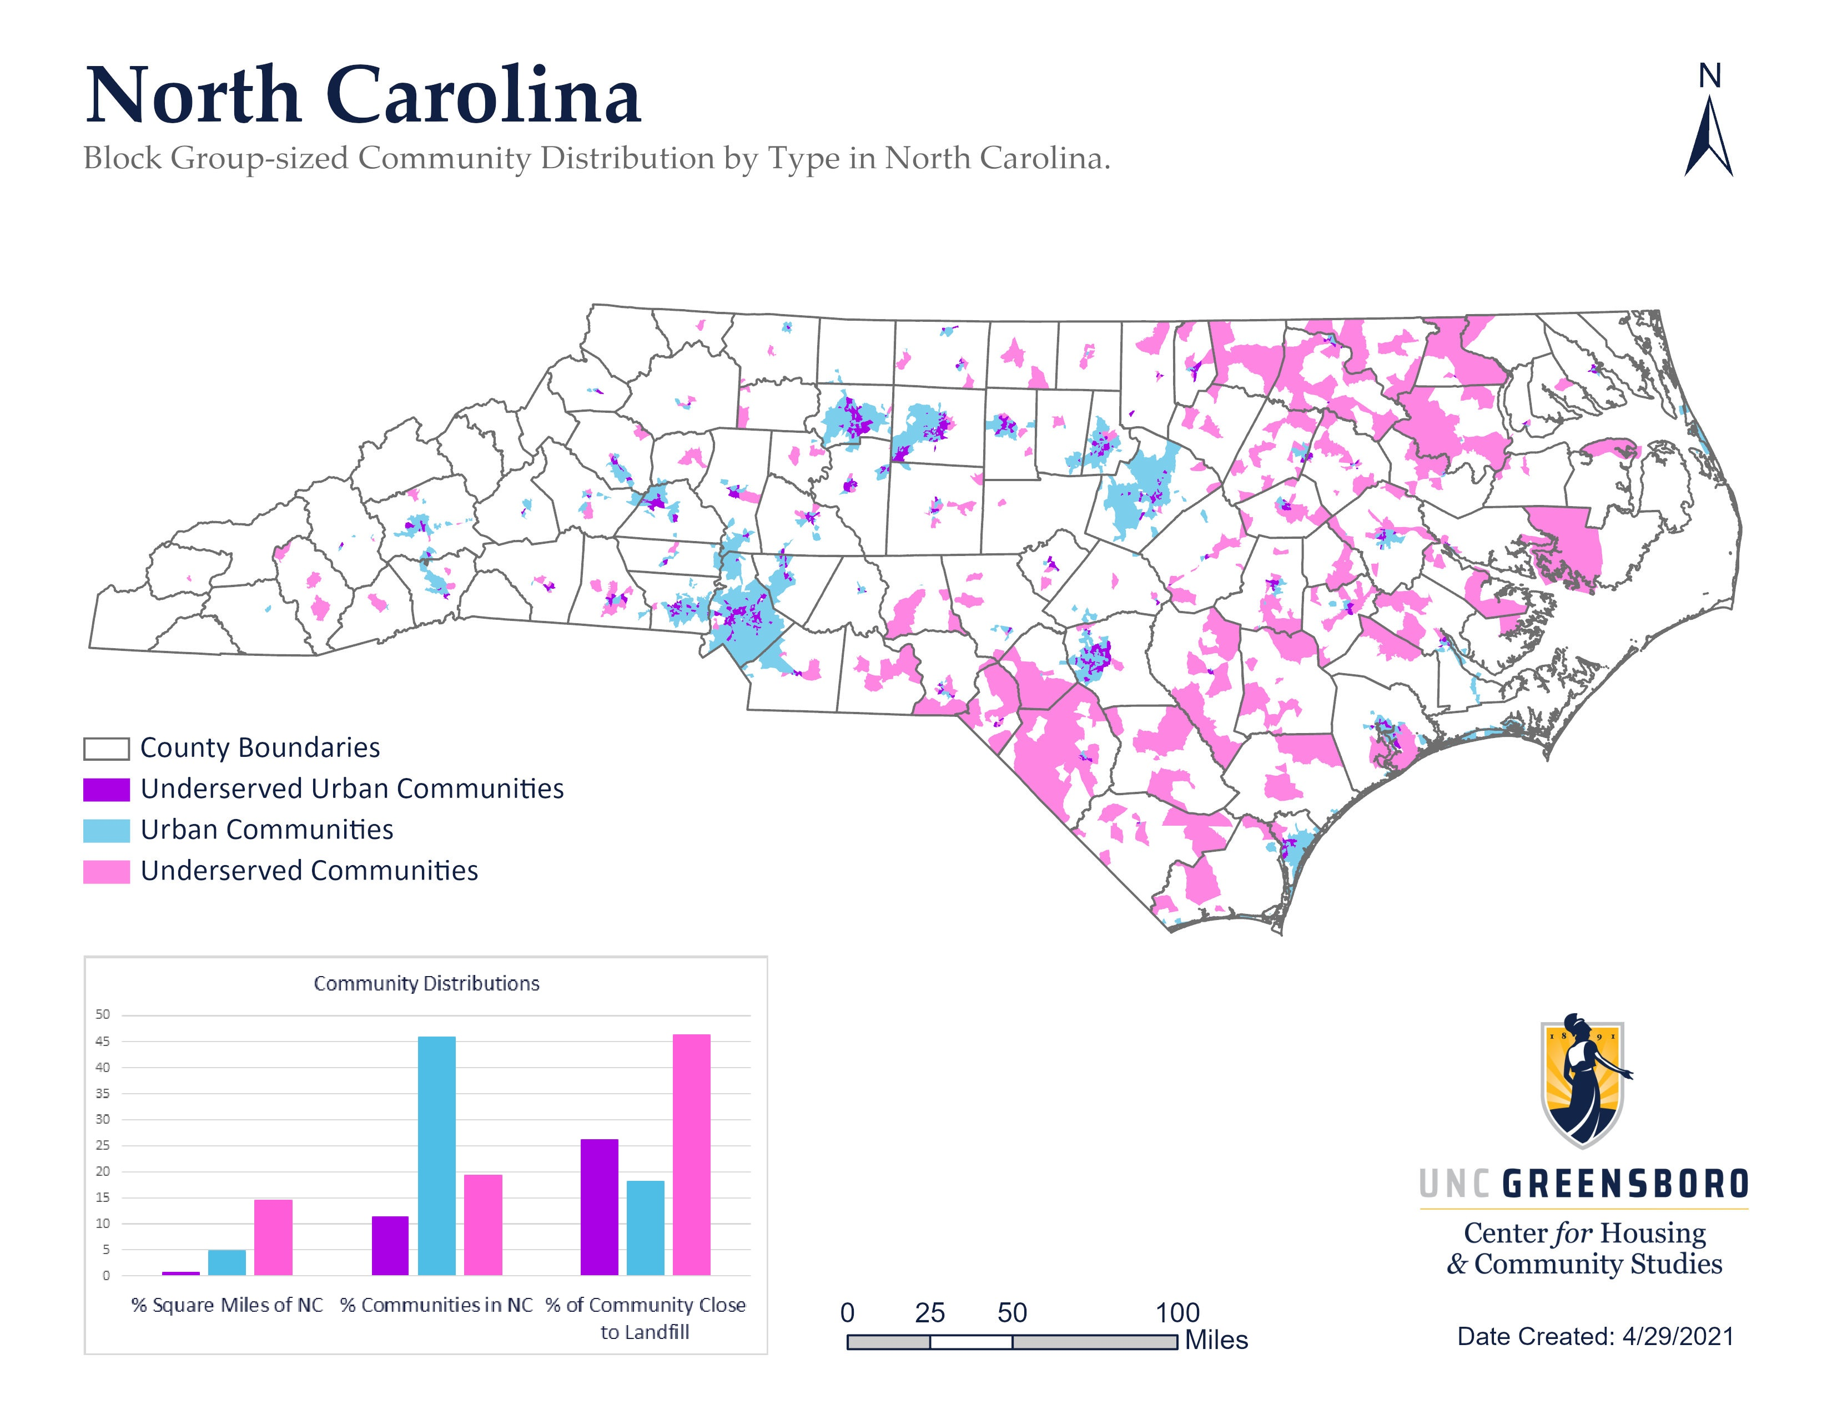

Slide 9
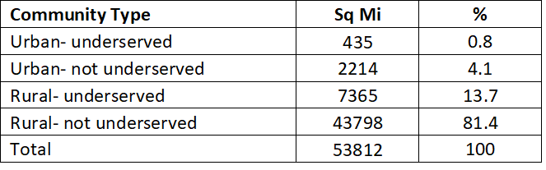
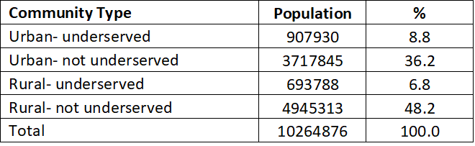
Across the state
Almost half of NC’s population lives in an urban area.
About 1 out of 11 residents in NC live in an underserved urban community.
Though urban geography accounts for about 5% of NC’s total square miles, about 27% of the state’s pre-regulatory landfill sites are located within 0.5 miles of these communities.

Slide 10
Underserved communities = 37.6% of PRLFs
Underserved urban communities make up less than 1% of NCs landscape, yet a quarter (26.2%) of this geographic area is within 0.5 miles of a pre-regulatory landfill site, accounting for about 13.2% of pre-regulatory landfill sites.
Community Type | N | Percent
Urban, Underserved | 87 | 13.2%
Urban, not Underserved | 90 | 13.7%
Rural, Underserved | 160 | 24.4%
Rural, not Underserved | 320 | 48.7%
Total | 657 | 100%
Notes:
Total underserved = 37.6%

Slide 11
Compiled Dataset Variables @ BG level
Landfill (Y/N)
#landfills
total population
population density
% White
% nonwhite
% Black
% Hispanic
% children
% over 65
Med HH income
% poverty
% renting
% uninsured
% unemployed
% HS or Less
% BA or Higher
% rural Population
Sources: ACS 2015-2019

Slide 13
Statistically Significant Correlations
Greater likelihood of landfills in..
  Block Groups with higher Rural Population
  Block Groups with higher Black Population
  Block Groups with residents over 65
  Block Groups with residents in Poverty
  Block Groups with residents who are Uninsured
  Block Groups with residents who have Less than HS
Less likelihood of landfills in..
  Block Groups with higher Population density
  Block Groups with higher Median HH Income
  Block Groups with residents who have BA

Slide 14
Are black communities disproportionately impacted?
Variables in the Equation
 |  | B | S.E. | Wald | df | Sig. | Exp(B)
Step 1ª | population density | -0.00093 | .000 | 105.706 | 1 | .000 | .999
 | %black | 0.00627 | .002 | 7.222 | 1 | .007 | 1.006
 | % Hispanic | -0.00058 | .005 | .012 | 1 | .913 | .999
 | %children | 0.00968 | .007 | 1.786 | 1 | .181 | 1.010
 | %over 65 | -0.00189 | .007 | .083 | 1 | .773 | .998
 | medHHincome | -0.00001 | .000 | 8.288 | 1 | .004 | 1.000
 | %poverty | 0.00846 | .005 | 2.384 | 1 | .123 | 1.008
 | %renting | 0.00665 | .004 | 3.436 | 1 | .064 | 1.007
 | %uninsured | -0.00063 | .008 | .006 | 1 | .939 | .999
 | %unemployed | -0.00054 | .001 | .365 | 1 | .545 | .999
 | %HS or Less | 0.00292 | .005 | .286 | 1 | .593 | 1.003
 | %BA or Higher | 0.01154 | .006 | 3.674 | 1 | .055 | 1.012
 | %rural Population | -0.00030 | .002 | .038 | 1 | .845 | 1.000
 | Constant | -1.850 | .520 | 12.634 | 1 | .000 | .157
a. Variable(s) entered on step 1: population density, %black, %Hispanic, %children, %over 65, medHHincome, %poverty, %renting, %uninsured, %unemployed, %HS or Less, %BA or Higher, %rural Population.
When all variables are taken into consideration together, we see that the likelihood of having a PRLF in a particular community increases about 1% for every 1% increase in the black population when accounting for other socioeconomic conditions.
Binary Logistic Regression
Notes:
Regression (Binary Logistic)

Slide 15
Conclusions
Cottage Grove/ Willow Oaks is not a unique case
While 19.4% of block groups are ‘underserved,’ 37.6% of PRLFs are in these communites – twice as many as would be expected if all things were equal.
Across the state in urban AND rural communities, poor communities of color are disproportionately impacted by PRLFs.
In urban, high population density, underserved areas addressing PRLFs presents additional challenges:
  historical racial injustices,
  trust and community engagement in the process, as well as
  the engineering challenges to remediate in a way that leaves the land safe residents in the future.
Addressing the environmental concerns cannot be done without recognizing the historical issues and disproportionate impact.

