Slide 1
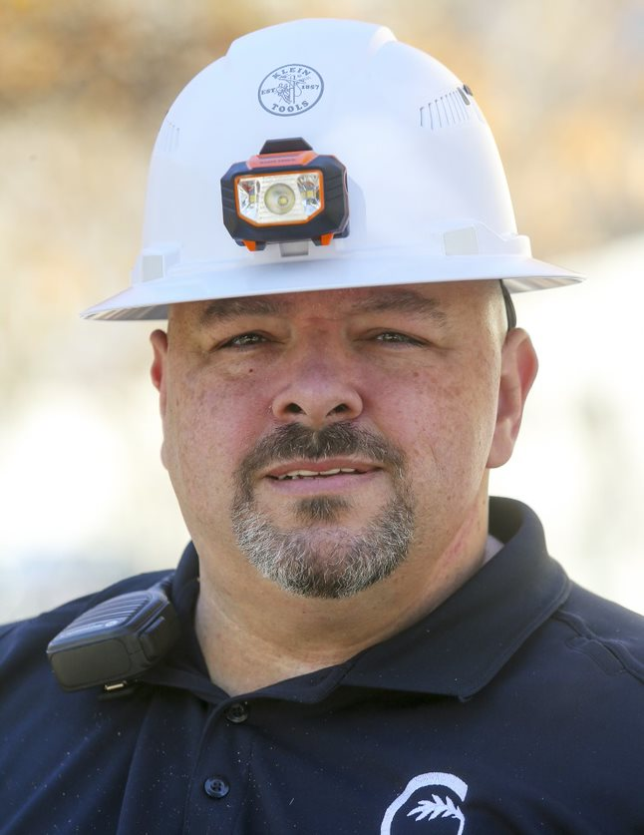
Neighborhood Development Department
Community Improvement Division
Troy D Powell, MPA, CZO
Division Manager

Slide 2
Outline
Risk of Health vs. Routine Repairs
Owner and Occupant Responsibilities
When to Call Code Enforcement
What is Condemnation?
Why Maintain Your Property Inside and Outside?
Property Self-Inspection
Tenants Working Together
How to Report a Violation
What to Expect in the Enforcement Process
Following Your Case Progress
Emergency Housing Assistance

Slide 3
RISK TO HEALTH OF OCCUPANTS
Risk to Health vs. Routine Repairs
Structurally Sound Building
No Hot Water, No Heat
Leaky Roof, Open Ceiling
Operable Plumbing
Safe Electrical System
Operable Heating System
ROUTINE REPAIRS
Changing Air Filters
Dripping Faucets
Running Toilets
Small Holes in the Carpet

Slide 4
Owner Responsibilities
City Ordinance Sec. 11-8
Owners Required to Repair in 48 Hours of Notification
Repair Broken, Burst, Frozen, Inoperable Plumbing Pipe or Fixtures
Repair any Exposed or Unsafe Wiring
Repair or Replace Unsafe or Dangerous Cooking or Heating Equipment Provided by Owner
Repair or Replace Fuel Storage Tanks or Supply Lines Leaking, Improperly Supported or Dangerous

Slide 5
Occupant Responsibilities
City Ordinance Sec. 11-9
Occupant Required to Repair in 48 Hrs of Notification
Keep Apartment in a Clean and Sanitary Condition
Keep All Plumbing and Fixtures Clean and Sanitary
Exterminate if Owner provided an Adequate Rodent-Proof Building and Only One Apartment Affected.
Dispose of Garbage in Approved Receptacles
No Furniture, Auto Parts, Junk, or Materials stored on premises that cause fire hazard or endangers health

Slide 6
Occupant Responsibilities
City Ordinance Sec. 11-9
Occupant Required to Repair in 48 Hrs of Notification
Maintain Fuel Storage Tanks in a Safe Condition
Not Occupy Unit without Water & Sewer Service Operable
Not Place in Structure any oil or gas fired portable or nonvented cook stove or heater
Not place on the Premises any Heating or Cooking unit Constituting a Serious Fire Hazard
Not Cause Damage to the Unit to Make Unit Unfit
Maintain Utilities when in Occupants Name

Slide 7
When to Call Code Enforcement
Unfit for Human Habitation, City Ordinance 11-10
Any Violation of Owner Responsibilities
Interior Walls Leaning, Buckling, Failing
Supports of Structure Damage or Deterioration
Floors or Roofs with Improperly Distributed Loads
Damage by Fire, Wind, Other Rendering an Unsafe Building
Dilapidation, Decay, Unsanitary Conditions or Disrepair

Slide 8
When to Call Code Enforcement
Unfit for Human Habitation, City Ordinance 11-10
Inadequate facilities for Egress in case of Fire or Panic
Defects Increasing Fire, Accident or Calamity Hazards
No Adequate Ventilation, Light, Heating, or Sanitary
No Proper Electrical, Heating, Plumbing Facilities
Any of These Conditions Can Result in Civil Penalties and Condemnation.
Condemnation Can Happen Sooner if a Threat to Occupants or the Public Safety

Slide 9
What is Condemnation?
Temporarily or Permanently Protecting Occupants or the Public from an Unsafe or Hazardous Condition.
Any of the Conditions of City Ordinance Sections 11-8, 11-9, 11-10 can Result in Civil Penalties and Condemnation
Condemnation can Occur sooner depending on the Threat to Occupants, the Public, or Failure to Comply with Order.
Condemnation means the Owner can’t Rent, Advertise for Rent, or Allow Anyone to Remain in the Structure Until all Violations are Corrected.

Slide 10
Why Maintain Your Property Inside and Outside
Reducing the likelihood of code violations or complaints filed against you
Preventing further deterioration of your property
Saving money in repairs later
Improving your family’s quality of life
Reducing crime

Slide 11
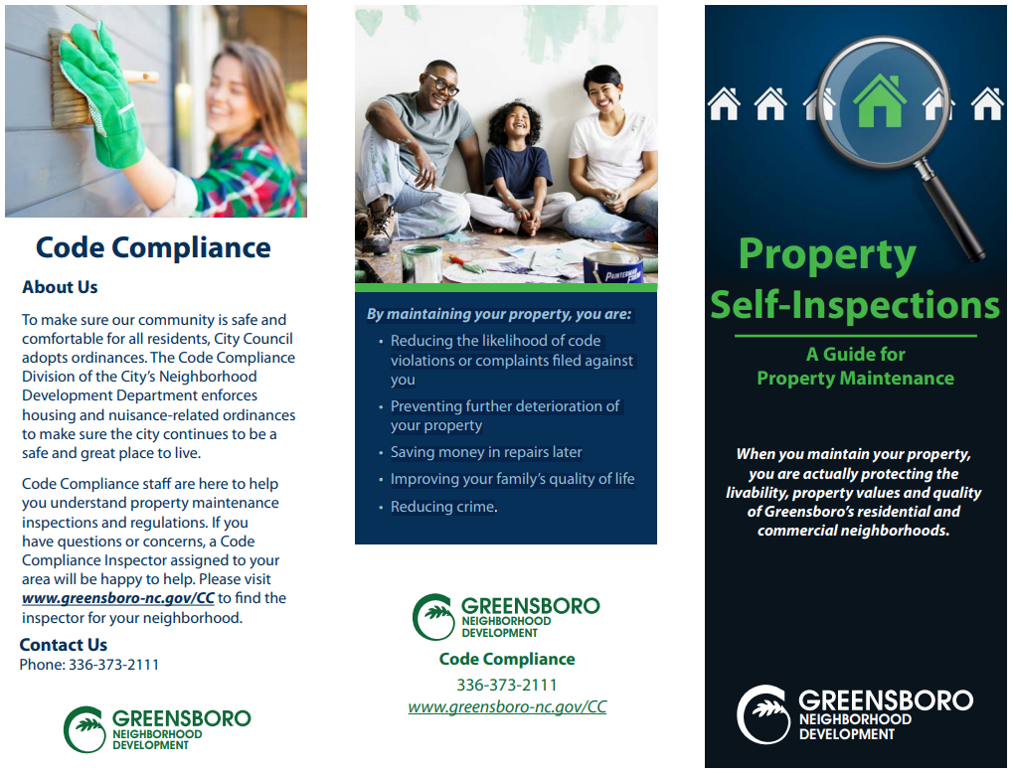
Property Self-Inspection

Slide 12
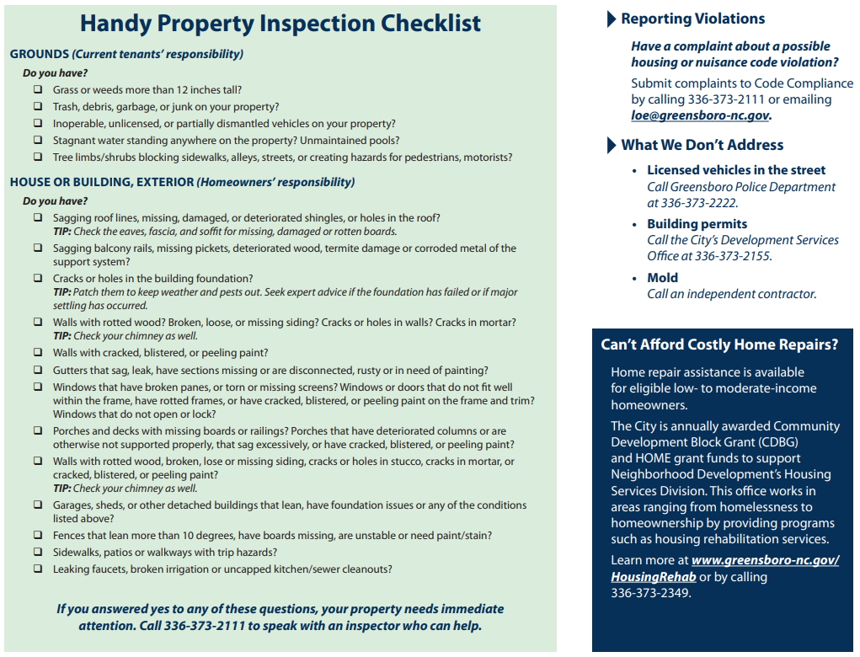
Property Self-Inspection

Slide 13
Tenants Working Together
Apartments in a Neglected Property Share Violations
Busted Windows, No Insect Screens
Plumbing, Electrical, Heating Issues
Doors Don’t Shut Easily, Door Jambs are Broken
Infestation of Multiple Apartment Units
Exterior of Property is not Maintained or Sanitary
Petition for a Housing Inspection
Unique Knowledge of Interior Conditions by 5 Citizens
Report Information Collectively to Code Compliance
Inspectors will Conduct Coordinated Inspections

Slide 14
How to Report a Violation
Contact the City Call Center at 336-373-CITY (2489)
Contact Code Compliance at 336-373-2111
Online Complaint Form www.greensboro-nc.gov/cc
E-mail Complaint to LOE@greensboro-nc.gov
What We Don’t Address:
Building Permits (Development Services)
Mold (Contact an Independent Contractor)
Home Owners Association Agreements (Contact Attorney)

Slide 15
Now That You Reported a Violation?
What to Expect
Initial Inspection (1/5 Rule)
Request Case Number, Inspector Name, and Phone
Administrative Hearing with Inspector
Issuance of Order to Repair or Demolish (50% Tax Rule)
Performance Period Monitoring for Compliance
Civil Penalty Issuance to Encourage Continued Compliance
Condemnation of Dwelling Unit
Ordinance Adoption by the Housing Commission

Slide 16
How to Follow Case Progress
Access the Public Code Compliance Portal
Go to www.greensboro-nc.gov/cc
Select “Status of Code Cases
Place a Check Mark in “Active” for “Case Status”
Upper Right on Map, Click Magnifying Glass
Enter Case Number or Your Address
Select “Report 1” or “Report 2” for your Case
When the Inspector Updates the File it Updates Overnight on this Portal
Call 336-373-2660 or Case Officer if No Progress

Slide 17
Emergency Housing Assistance
www.greensboro-nc.gov/nd
Resources for Emergency Assistance
Homeless or Will be in 72 Hours (Homeless Prevention)
Coordinated Entry 336-553-2716
www.guilfordcoc.org
Resource Guide
Greensboro Housing Coalition (ETAP)
ND Housing Services Emergency Repair

Slide 18
Any Questions
CONTACT INFORMATION
Troy D Powell, Division Manager
336-373-2208
Troy.Powell@Greensboro-NC.Gov
CONNECT WITH YOUR INSPECTOR
Admin Office 336-373-2111
Admin Supervisor 336-373-2660

